Slide 1
moments

Slide 2
Moments
In statistics moments are certain constant values in a given distribution which help us to ascertain the nature and form of distribution.
The shape of any distribution can be described by its various ‘moments’. The first four are:
1) The mean, which indicates the central tendency of a distribution.
2) The second moment is the variance, which indicates the width or deviation.
ML LABS PVT LTD || WWW.ANALYTICS6.COM || DATA SCIENCE , AI , ML ,COMPUTER VISION || TRAINING AND CONSULTING
Phone Number : 91-6362546088 || Email : contact@analytics6.com

Slide 3
Moments
2) The second moment is the variance, which indicates the width or deviation.
3) The third moment is the skewness, which indicates any asymmetric ‘leaning’ to either left or right.
4) The fourth moment is the Kurtosis, which indicates the degree of central ‘peakedness’ or, equivalently, the ‘fatness’ of the outer tails.
ML LABS PVT LTD || WWW.ANALYTICS6.COM || DATA SCIENCE , AI , ML ,COMPUTER VISION || TRAINING AND CONSULTING
Phone Number : 91-6362546088 || Email : contact@analytics6.com

Slide 4
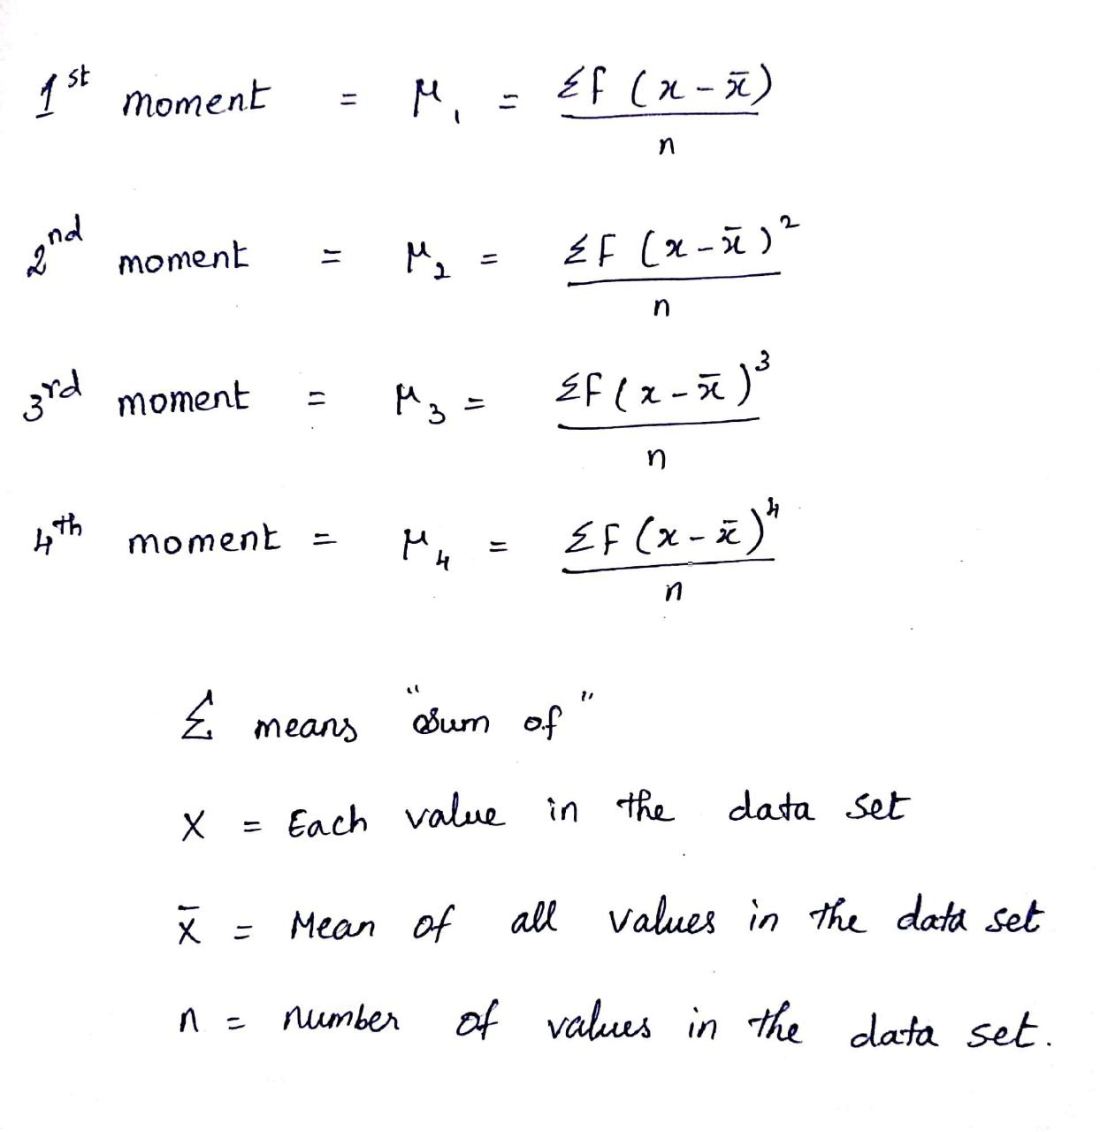
Moments
The formula for calculating moments is as follows:
ML LABS PVT LTD || WWW.ANALYTICS6.COM || DATA SCIENCE , AI , ML ,COMPUTER VISION || TRAINING AND CONSULTING
Phone Number : 91-6362546088 || Email : contact@analytics6.com

Slide 5
ML LABS PVT LTD || WWW.ANALYTICS6.COM || DATA SCIENCE , AI , ML ,COMPUTER VISION || TRAINING AND CONSULTING
Phone Number : 91-6362546088 || Email : contact@analytics6.com

